Slide 1
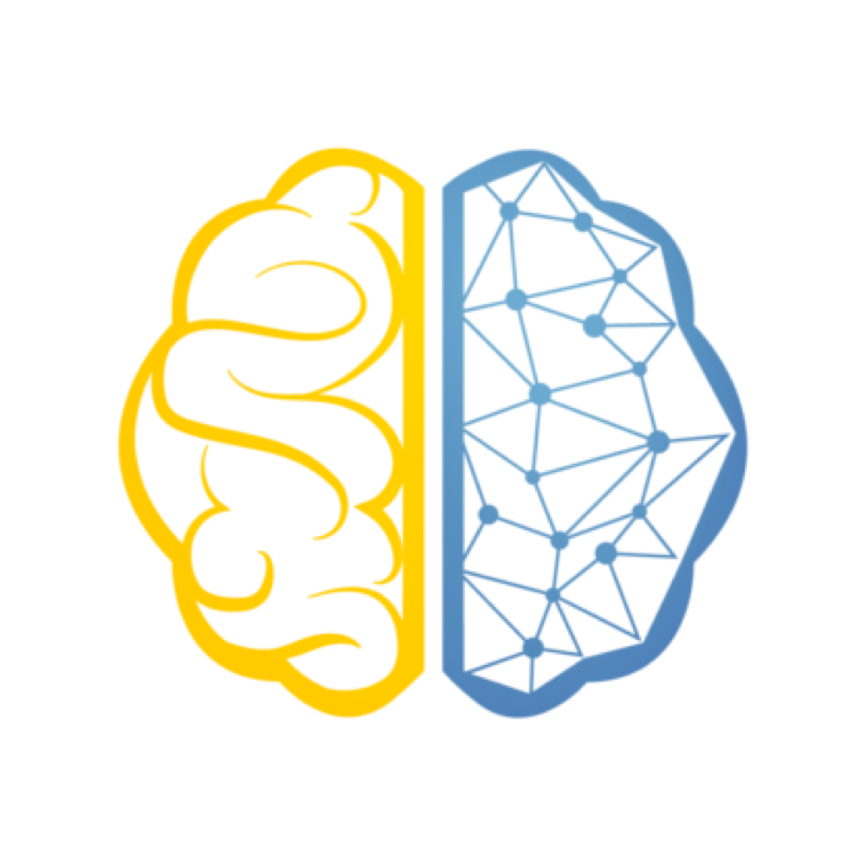

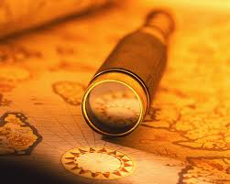


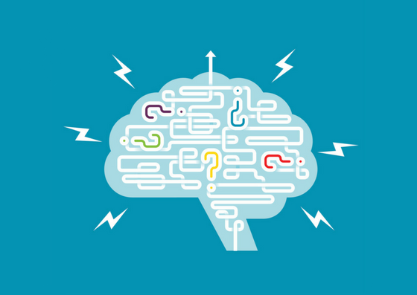
QUICK SUMMARY
Goal
Used a convolutional neural network (CNN) to Classify the anatomy then classify if there is an abnormality in that image
Workflow
Explore & Organize data
Process the Images
Customize & Optimize the CNNs
Train the CNNs
Predict with the models

Slide 2
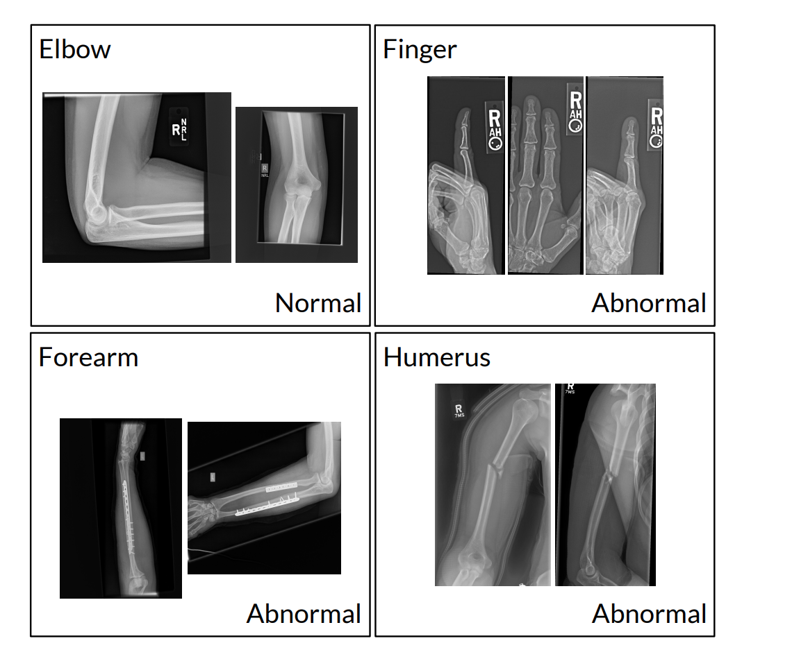
The Dataset
MURA dataset
40,561 X-rays
Body parts:
Finger
Hand
Wrist
Forearm
Elbow
Humerus
Shoulder

Slide 3
